Slide 1
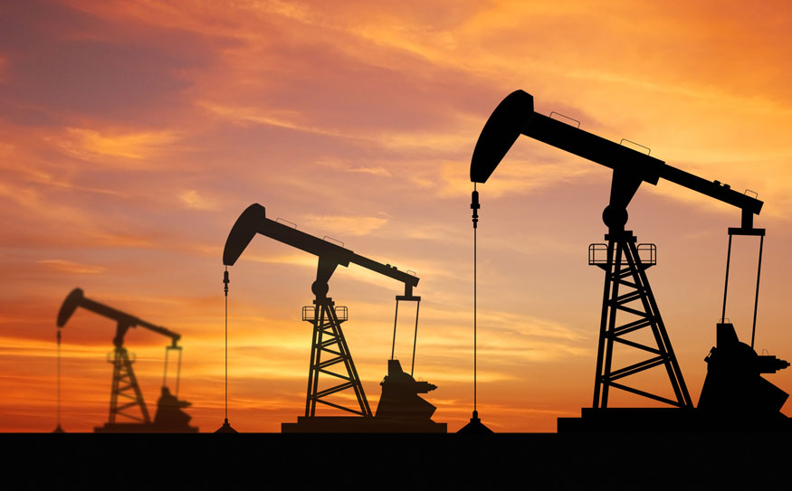
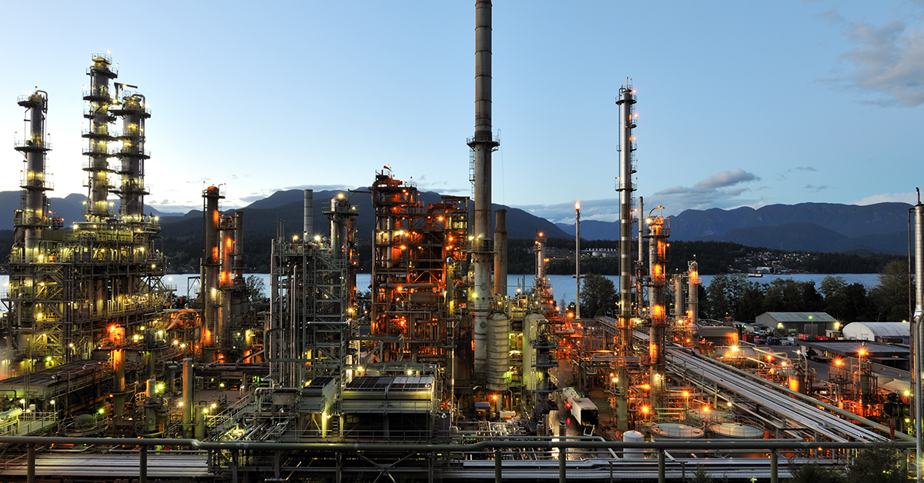
Demand and Supply of Oil and Gas
This Photo by Unknown Author is licensed under CC BY
This Photo by Unknown Author is licensed under CC BY-ND

Slide 2
Contents
Oil and Gas
Production of Oil
Supply of Oil
Demand of Oil
Production of Gas
Supply of Gas
Demand of Gas
Conclusion
References

Slide 3
Oil and Gas:
Oil and gas are the most commonly used sources of fuel and energy production in the world. However, the rapidly increasing demand for these fossil fuels has put a strain on the limited supply which is available to us. The causes and effects of this issue can be seen as follows:
OPEC Influences Prices
Weak dollar
Natural Disasters, Politics Weigh
Political Instability
Covid-19

Slide 4
Saudi Arabia, which is commonly known as the biggest producer of oil, produces an average of 10 million barrels per day of oil. In 2020, the median production was 11.01 million barrels per day, as can be seen from the below graph.
Production of Oil:
[1]

Slide 5
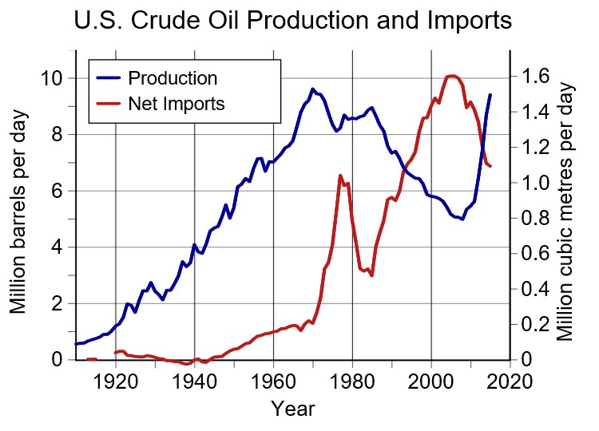
Supply of Oil:
[2]
In 2020, oil production in the United States reached 16.5 million barrels per day, the highest point in history. The United States currently produces more oil than any other country in the world.
All in all, the total world oil production in 2020 averaged 76 million barrels per day.

Slide 6
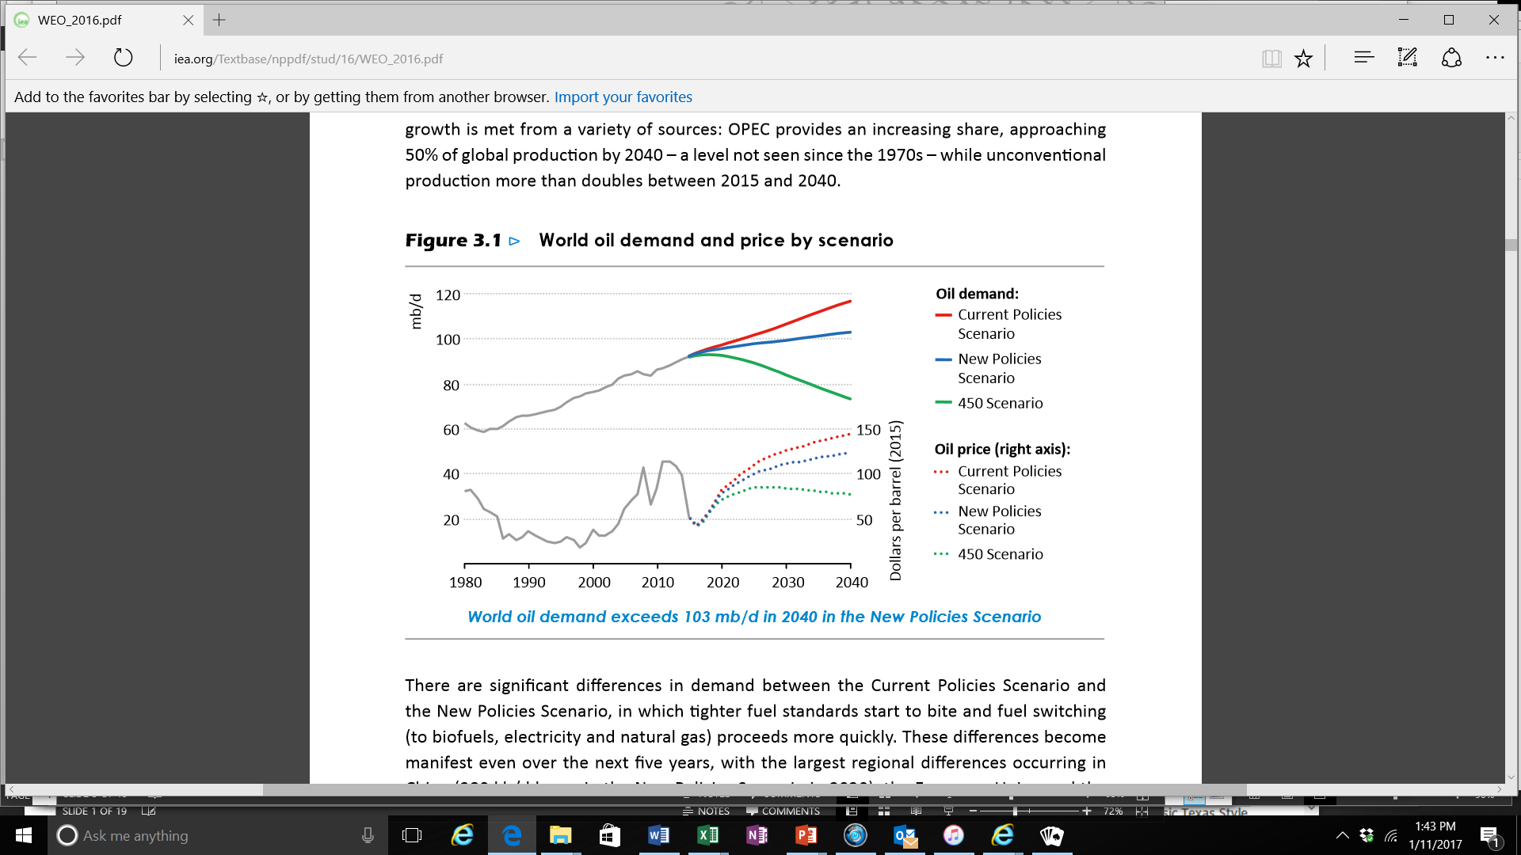
[3]
Demand of Oil:
According to the latest estimate by the US Energy Information Administration (EIA), oil supply exceeded demand by around 6 million barrels per day in the first quarter of 2020 and the gap is expected to extend to 11.4 million barrels per day in the second quarter.

Slide 7

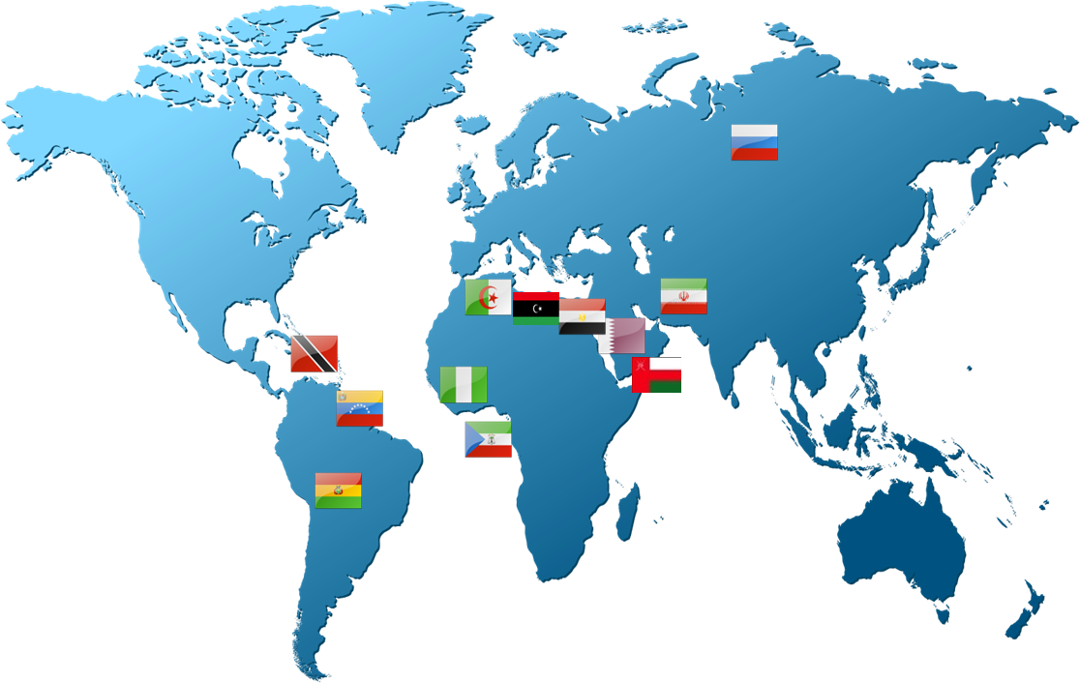





















Production of Gas:
Gas Exporting Countries Forum (GECF)
[4]
MEMBERS
OBSERVERS
Algeria
Azerbaijan
Bolivia
Iraq
Egypt
Kazakhstan
Equatorial
Guinea
Norway
Iran
Oman
Libya
Peru
Nigeria
Qatar
Russia
Trinidad
and Tobago
70%
45%
64%
54%
United Arab
Emirates
Venezuela
Gas Reserves
(144 Tcm)
Gas Production
(1,650 Bcm)
Pipeline Gas Exports
(447 Bcm)
LNG Exports
(156 Mt)

Slide 8

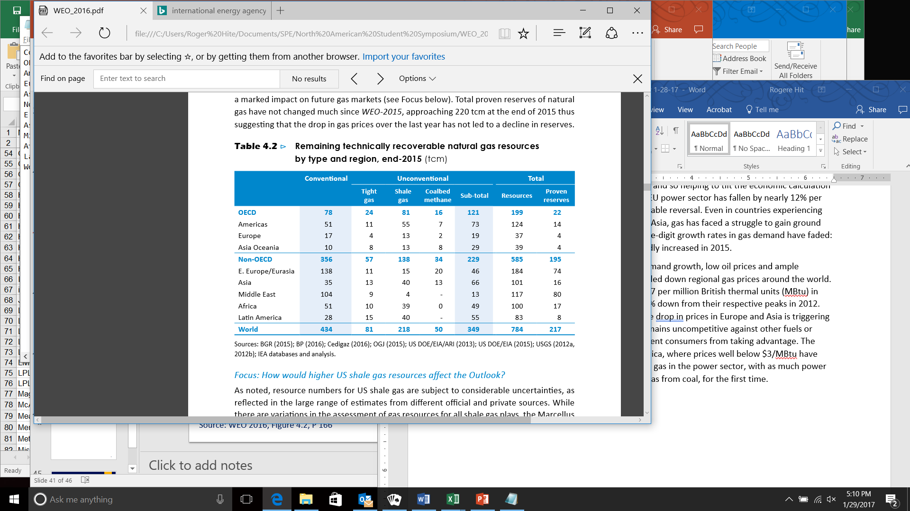
Supply of Gas:
[5]
Based on an estimated 2015 world consumption rate of about 3400 km³ (815 cu. mi.) of gas per year, the total estimated remaining economically recoverable reserves of natural gas would last 250 years at current consumption rates. An annual increase in usage of 2–3% could result in currently recoverable reserves lasting significantly less, perhaps as few as 80 to 100 years.
8
Source: WEO 2016, Table 4.2, P 176

Slide 9
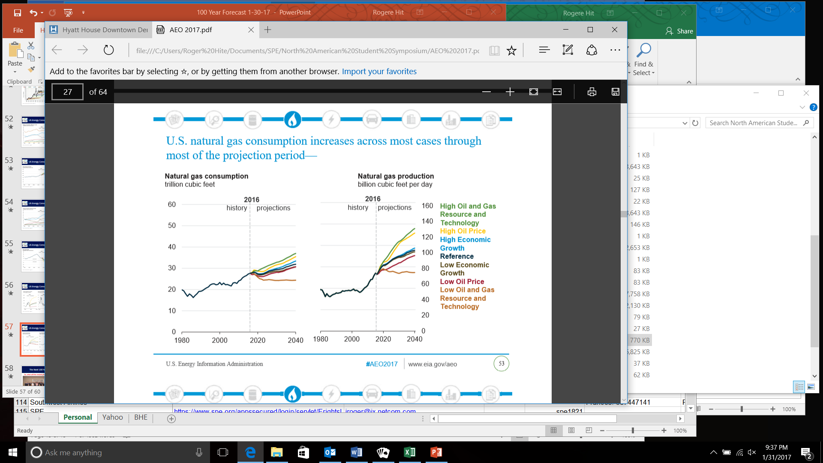
Demand of Gas:
[6]
Global gas demand is expected to rise by 3.6% in 2021 before easing to an average growth rate of 1.7% over the following three years, according to the IEA's latest quarterly Gas Market Report, which also provides a new medium-term forecast. By 2024, demand is forecast to be up 7% from 2019's pre-Covid levels.

Slide 10
Conclusion:
Oil and gas demand is forecasted to increase steadily in the future.
Oil and gas will play an important role in energy supply for the next 25 years.
This is true whether you support Climate Change or not.
Careers in oil and gas look secure.
Oil and gas demand is not expected to overtake production within the next 50 years.

Slide 11
References:
US Energy Information Resource (EIA)
Energy Information Resource (EIA) AEO, 2017
Energy Information Resource (EIA) WEO, 2016
Gas Exporting Countries Forum (GECF)
Energy Information Resource (EIA) WEO, 2016
Energy Information Resource (EIA) AEO, 2017

